Slide 1
Travel Salesman Problem

Slide 2
Agenda
Introduction
TSP applications
Theoretical approach
Solving techniques
Implementation approach
Greedy algorithm
Dynamic programming
Comparison
References

Slide 3
Introduction
The travelling salesman problem consists of a salesman and a set of cities, the salesman has to visit each one of the cities , starting from a certain one and returning to the same city .
The challenge of the problem is that the travelling salesman wants to minimize the total cost of the trip without visiting a city twice or ignoring one of them .

Slide 4
TSP Applications
The routing of courier trucks
The manufacture of microchips
Planning

Slide 5
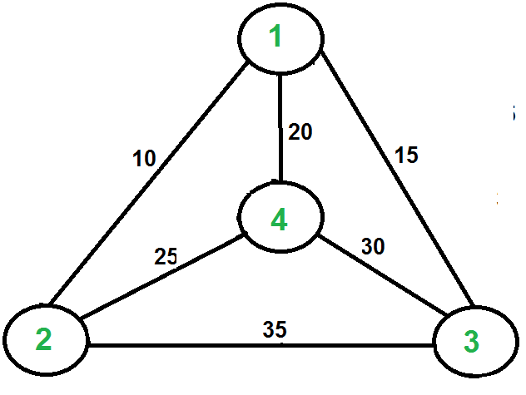
Theoretical Approach
Undirected weighted graph
Cities are the graph’s vertices
Paths are the graph’s edges
Optimal TSP tour is the shortest Hamiltonian cycle.
A Hamiltonian cycle is a cycle that visits every vertex exactly once .
NP Hard problem

Slide 6
Solving Methods
Travel Salesman
Divide and Conquer
Genetic Algorithm
Dynamic Programming
Greedy Algorithm

Slide 7
Implemented Approach
Greedy algorithm
Dynamic programming

Slide 8
I. Greedy Approach

Slide 9
Greedy Algorithm
What is Greedy Algorithm ?

Slide 10
Greedy Approach
Minimum Spanning Tree
Dijkstra’s algorithm for shortest paths from a single source
Nearest Neighbour Algorithm.

Slide 11
Nearest Neighbour Algorithm

Slide 12
Nearest Neighbour Algorithm

Slide 13
Greedy Algorithm
Advantages :
Easy to Implement
Knowing the Time Complexity is quite easier than backtracking Approaches .
Disadvantage:
It does not give the optimal solution.
Proving that a greedy algorithm is correct is difficult.
Time Complexity: O(N²) | Space Complexity: O(N)

Slide 14
II. Dynamic programming

Slide 15
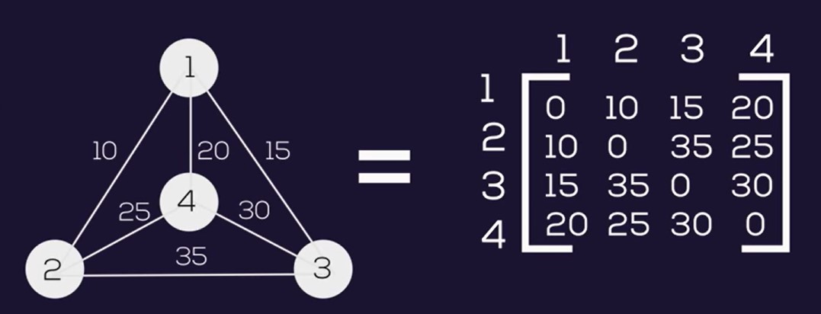
Adjacency matrix

Slide 16
Naive Solution
1
2
3
4
3
4
2
4
2
3
4
3
4
2
3
2

Slide 17
Formula
g(i, s) = min_{k∈s} {C_{ik} + g(k, s-{k})}
i starting point
s set of neighbours
C path cost

Slide 18
g(1, {2,3,4}) = min_{k∈s} {C_{1k} + g(k, {2,3,4}-{k})}
1
2
{C₁₂ + g(2, {3,4}}
3
{C₁₃ + g(3, {2,4}}
4
{C₁₄ + g(4, {2,3}}
3
{C₂₃ + g(3, {4}}
4
{C₂₄ + g(4, {3}}
2
{C₃₂ + g(2, {4}}
4
{C₃₄ + g(4, {2}}
2
{C₄₂ + g(2, {3}}
3
{C₄₃ + g(3, {2}}
4
{C₃₄ + g(4, {Φ}}
3
{C₄₃ + g(3, {Φ}}
4
{C₂₄+ g(4, {Φ}}
2
{C₄₂ + g(2, {Φ}}
3
{C₂₃ + g(3, {Φ}}
2
{C₃₄ + g(2, {Φ}}

Slide 19
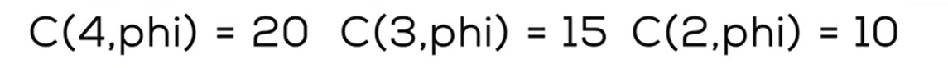
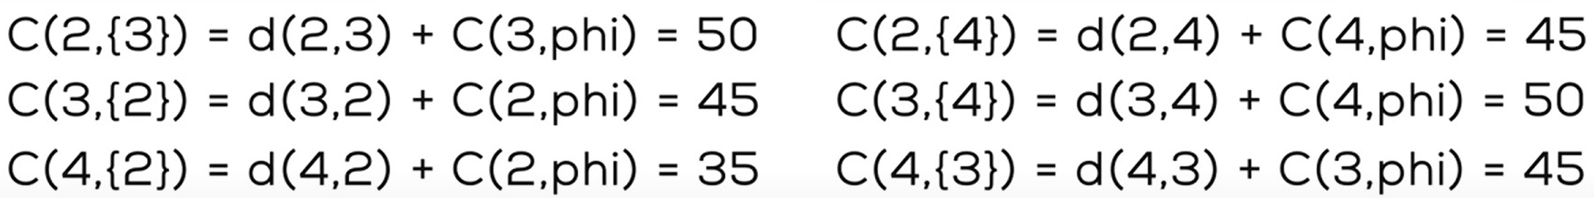
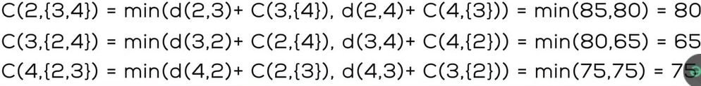
Bellman Held–Karp algorithm
70)
70
75

Slide 20
g(1, {2,3,4}) = min_{k∈s} {C_{1k} + g(k, {2,3,4}-{k})}
1
70+10=80
75+20=95
65+15 = 80
2
min(85,70) + 10
3
min(80,65) +15
4
min(75,75) + 20
3
35 + 50
4
25+ 45
2
35+ 55
4
30+35
2
25+ 50
3
35+ 40
{C₃₄ + g(4, {Φ}}
{C₄₃ + g(3, {Φ}}
{C₂₄ + g(4, {Φ}}
{C₄₂ + g(2, {Φ}}
{C₂₃ + g(3, {Φ}}
{C₃₄ + g(2, {Φ}}
30+20
30+15
35+20
25+10
35+15
30+10

Slide 21
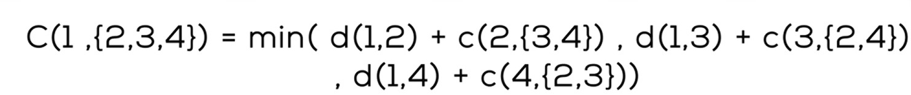
Final path
Optimal cost = min(80,80,95)=80
Optimal path : 1-2-4-3-1

Slide 22
Comparison
Point of Comparison | Naive | Dynamic Programming | Greedy Algorithm
Time Complexity | O(N!) | O(n²*2^{n}) | O(N²)
Space Complexity | O(N-1!) | O(2^{n}) | O(N)
Implementation | Simple | Difficult comparing to greedy | Easier than Dynamic
Efficiency | Good as N<10 | Optimal | Less optimal than dynamic

Slide 23
Resources
Traveling Salesman Problem (TSP) Implementation
Traveling Salesman Problem – Dynamic Programming Approach
4.7 [New] Traveling Salesman Problem - Dynamic Programming using Formula
Travelling Salesman Problem | Set 2 (Approximate using MST)
Travelling Salesman Problem. Greedy Algorithm | by Dhayaalan Raju | IVYMobility TechBytes
Prim's Algorithm

Slide 24
Thank you

